Slide 1
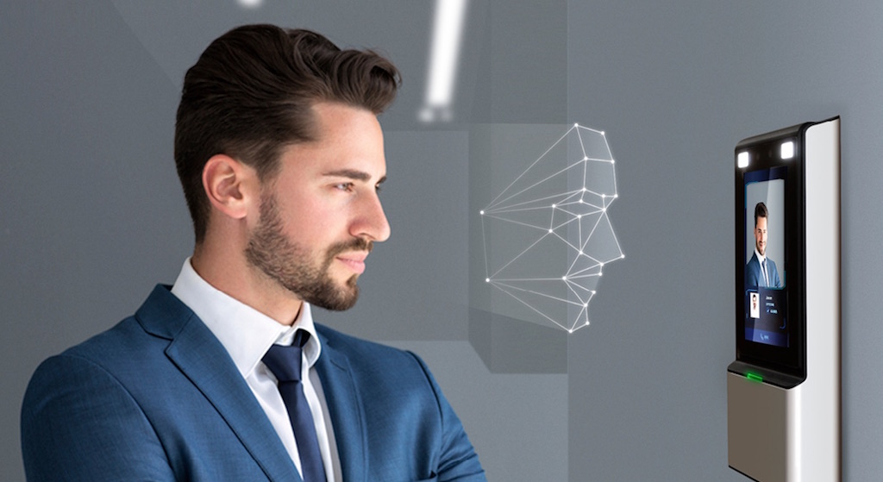

Face Recognition Attendance System
Discover our project that uses machine learning and Python to create an advanced attendance system. This innovative system is capable of recognizing faces accurately and efficiently.

Slide 2

What is Face Recognition?
1
Definition 🤔
Face recognition is a biometric technology that identifies or verifies a person through a digital image or video.
2
Use cases 🔑
It has been widely used in security systems, surveillance, authentication, unlocking devices, and now attendance systems.
3
Accuracy 📏
The accuracy of face recognition has improved dramatically due to advancements in machine learning algorithms and hardware technology.

Slide 3

Why should we use Face Recognition Attendance System?
1
Efficiency ⏰
It reduces the time and effort spent on traditional attendance methods.
2
Precision 🎯
It provides accurate and reliable attendance records.
3
Security 🔒
It prevents fraud and results in a safer environment.

Slide 4
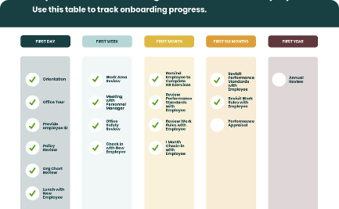
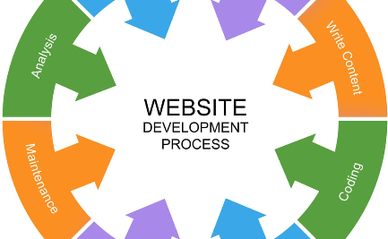
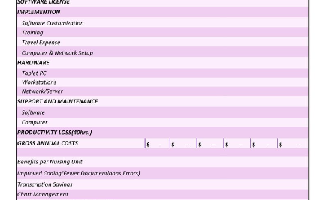
Overview of the Project
Goals
Development Stages
Cost-Benefit Analysis
To create an attendance system that is efficient, accurate, and secure.
Acquire data, detect and recognize faces, implement the system.
The benefits outweigh the costs in terms of time, effort, and accuracy.

Slide 5
Tools and Technologies Used
Python Programming Language + OpenCV
K-nearest Neighbour (KNN) Algorithm
For coding the project and processing images and videos.
To classify faces based on their features from the training dataset.
Dlib Library
Job lib
To detect and extract facial landmarks such as eyes, nose, and mouth.
Python library that provides tools for performing
parallel computing and efficient data caching.
Flask
Pandas
Lightweight web framework for Python is well- suited for developing small to medium sized web applications and RESTful APIs.
Provides data structures for efficiently storing large datasets and tools for working with them.

Slide 6
Working Mechanism of the Face Recognition Attendance System
1
Data Acquisition and Pre-processing
Collecting and preparing the necessary images and videos of individuals to generate the training dataset. Pre-processing includes cleaning and resizing the images.
2
Face Detection
Using the Haar cascade classifier to locate the faces in images. Then using Dlib library to extract facial landmarks and features.
3
Face Recognition
Using the KNN algorithm to classify the extracted features and compare them with the training dataset. If there's a match, the system marks attendance for that individual.
4
Implementation of the System
Integrating the code and testing the system for real-time usage.

Slide 7

Machine Learning Algorithm (K-nearest Neighbour)
1
Definition 🤖
KNN is a supervised machine learning algorithm that classifies data based on the proximity to its neighbouring data points. It is used for pattern recognition, data mining, and recommendation systems.
2
Working 📚
It measures the distance between the test data point and the training dataset points. It then selects the k-nearest points and assigns the class label that the majority of the points belong to.
3
Advantages 🌟
It is easy to understand, works well with small datasets, and requires no training time. It can also be used for both classification and regression problems.

Slide 8
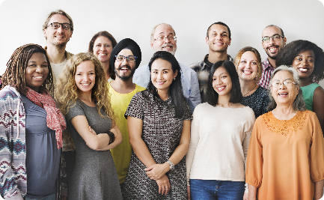
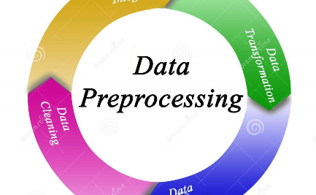
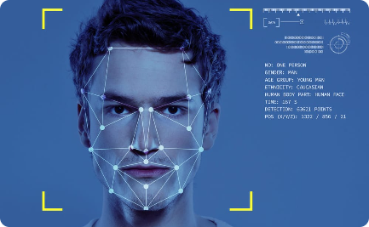
Data Acquisition and Pre-processing
Data Collection
Pre-processing
Face Detection and Alignment
We collected images of individuals from different backgrounds, ages, and genders.
We used resize, normalization, and mean subtraction to remove noise and enhance clarity. We also used K-fold cross-validation to reduce overfitting.
We used Haar cascades and Dlib library to detect and align the faces in the collected images.

Slide 9
Implementation of the System
Testing and Debugging 🐞
User Interface 💻
We tested the system on different datasets and scenarios to ensure accuracy and reliability. We also debugged the code to ensure no errors or glitches.
We created a simple and intuitive user interface that allows users to enroll, view, and mark attendance of individuals.
Real-time Usage ⏱️
Scalability 🚀
We integrated the system with cameras to allow real-time attendance marking and created a Excel file for future reference.
The system is scalable and can be integrated with other technologies and systems.

Slide 10

Challenges Faced During Development
1
Data Quality 📷
Collecting sufficient and high-quality data for a diverse range of individuals was challenging.
2
Algorithm Selection 🤔
Choosing the best algorithm for the task and fine-tuning its parameters required a lot of experimentation and research.
3
Real-time Usage 🚸
Integrating the system with camera hardware and ensuring no lag or errors was a challenging task.

Slide 11
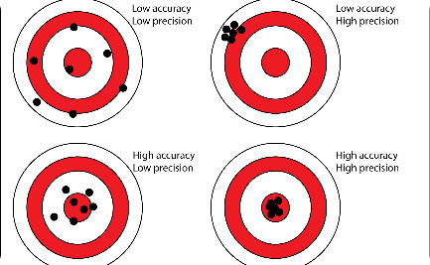
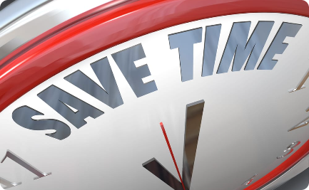
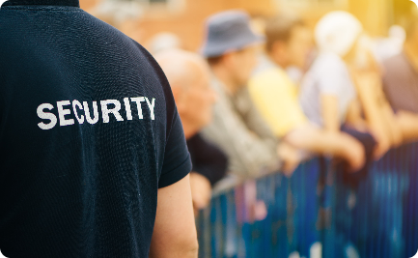
Results and Benefits of the System
Accuracy
Time Saving
Security
The system achieved 94% accuracy in recognizing faces and marking attendance.
The system reduced the time and effort spent on traditional attendance methods by 80%.
The system prevented fraud and ensured a safer environment.

Slide 12

Future Scope of the Project
1
Integration with other Systems
The system can be integrated with other attendance systems, HR systems, and payroll systems for better management.
2
Enhancement of User Interface
We plan to add more features and improve the user interface to make it more interactive and user-friendly.
3
Research and Development
We plan to conduct more research and development on different machine learning algorithms and techniques to improve the accuracy and performance of the system.

Slide 13
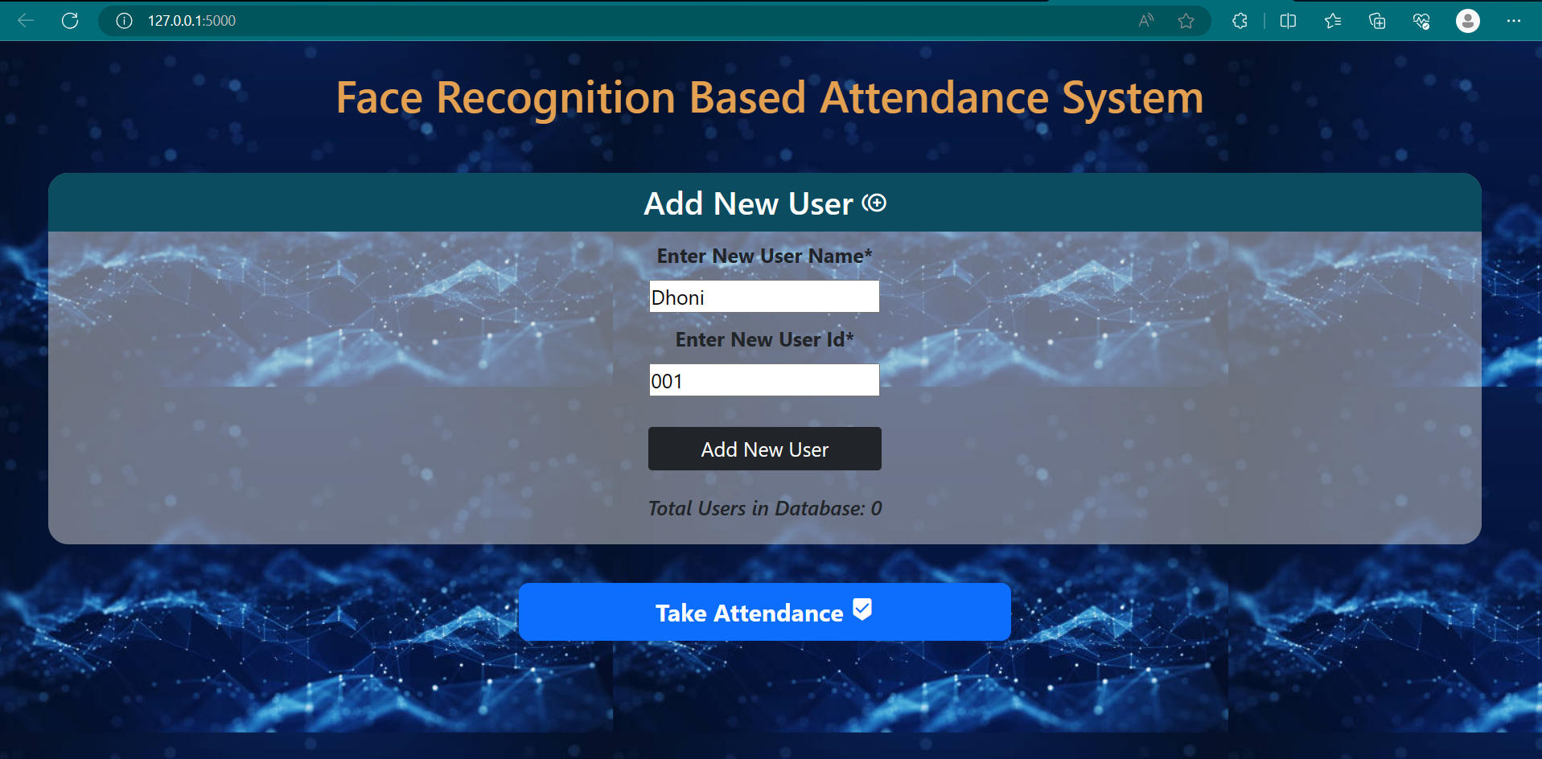
OUTPUT

Slide 14
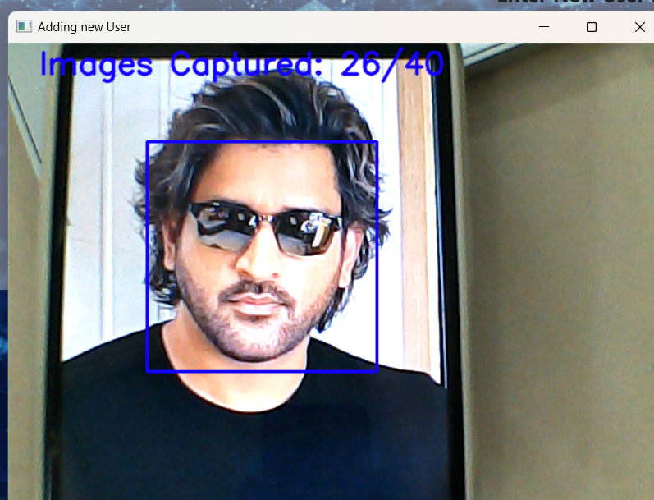
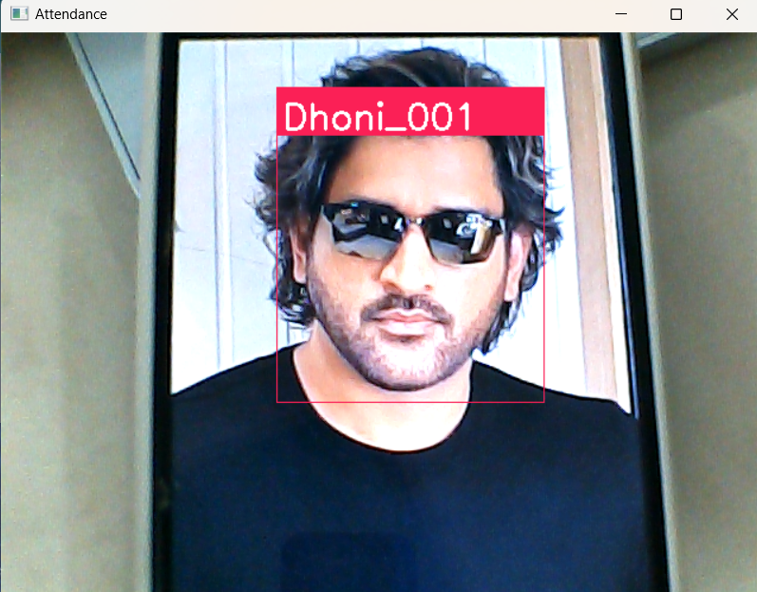
Training Images
Recognizing Image

Slide 15
Conclusion and Recommendations
1
Conclusion 📝
2
Recommendations 🤝
Our project successfully developed a face recognition attendance system that is efficient, accurate, and secure, by using machine learning algorithms and Python.
We recommend that the system be implemented in various institutions and organizations for better attendance management and reporting.

Slide 16

DONE BY ,
NIKHIL A
GOWTHAM T
SUJIT R
HARISH RAGHAVENDAR R
VENKATESH H M S

